Slide 1


Secure Document Personalisation
Mark Bond - Regional Manager
EMEA & APAC

Slide 2


US company with a global presence
End-to-end security printing solutions
Bespoke software, printers and consumables for secure document personalisation
Only TROY Authorised by HP to enhance printers, and cartridges for security printing
Help Governments manage fraud, operational risk and comply with global regulations

Slide 3



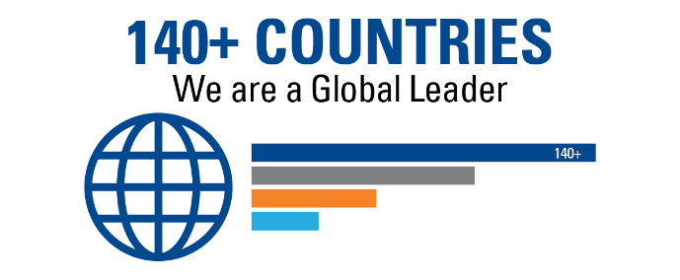




WE ARE TROY
55+ YEARS
5 BILLION ANNUALLY
Building Trust & Security
Checks Printed Globally with our MICR Toner
1963

Slide 4

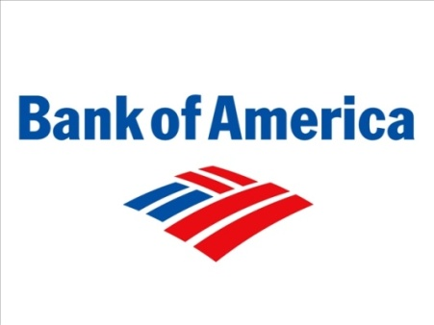






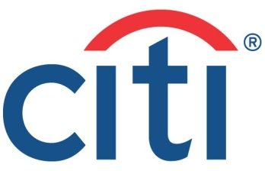







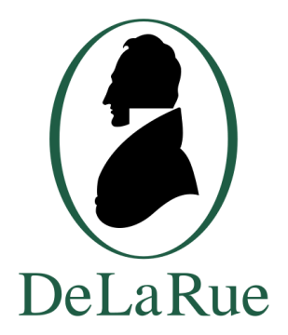





..some of our customers..

Slide 5

Accreditations

Slide 6

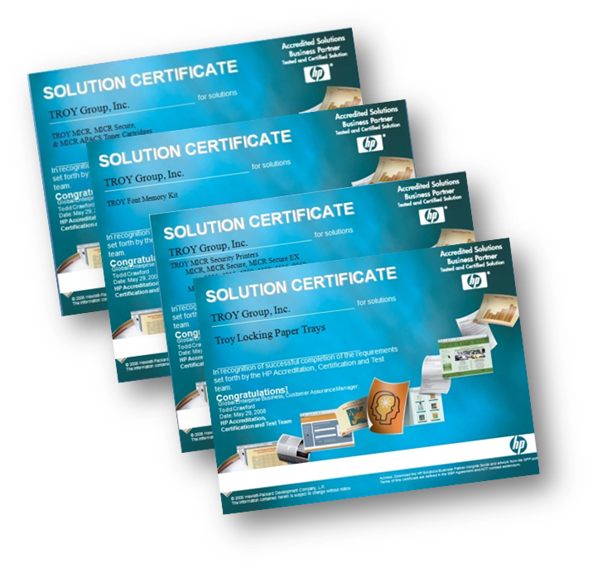



TROY - HP Relationship
HP IPG
WW Partner of the Year

Slide 7

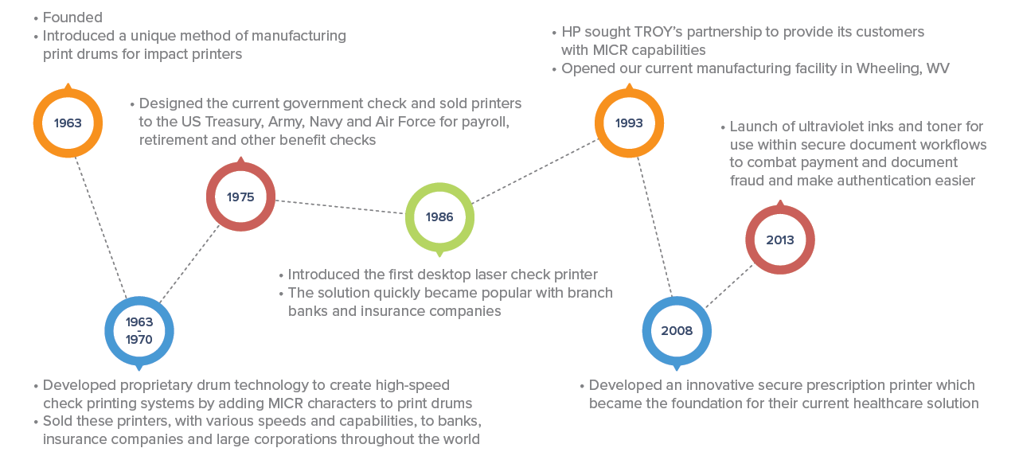
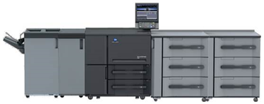
TROY’s MICR History
2020
Launch of 6136

Slide 8

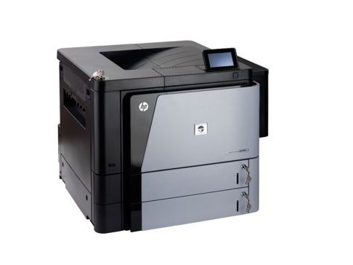
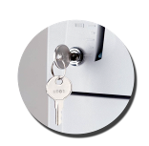
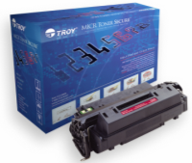
Four Approaches to Security
TROY is the only company in the world authorised by HP to modify and resell HP LaserJet Security printers and specialist toner cartridges.
TROY Solution Enhancements
Secure Software
Security features on the finished document with TROY SecureDocs Software
Printer
Built-in key-lock authentication
Built-in paper tray security
Electronic Security toner sensing
Firmware
Machine-readable and security fonts
Microtext and Copy-Void Pantograph
Encryption / decryption
TroyMark ™ Anti-Tampering Tech.
Toner & Ink
Security, UV, Fluorescing, MICRtoners and inks
Toner sensing magnet
Laser Indelible Solution

Slide 9
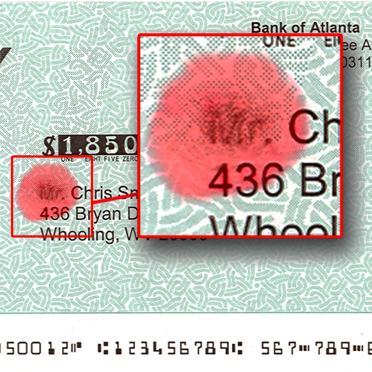
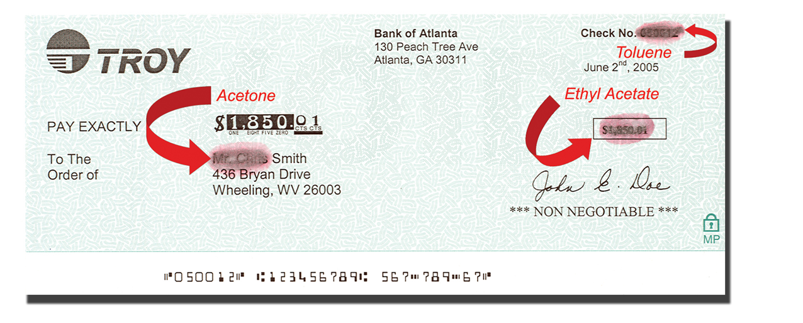
TROY MICR Toner Secure
Advanced Solvent Sensitivity
patented, anti-fraud technology which forces a red stain to appear if chemical alteration is attempted
visible signs of attempted alteration on MICR line and any personalisation

Slide 10

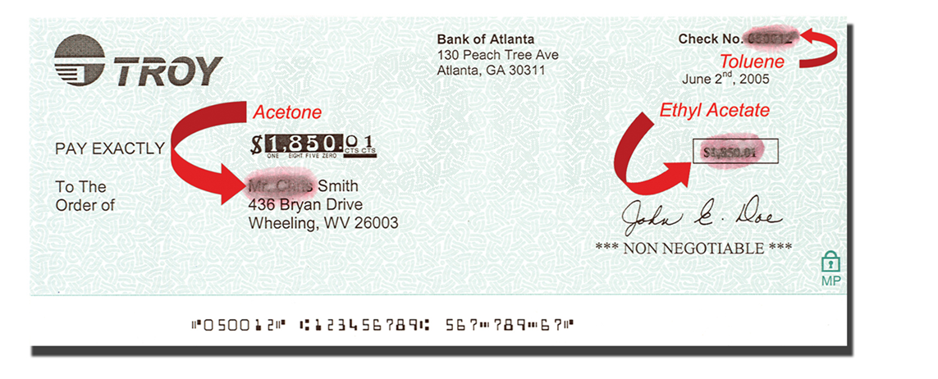
TROY Security Toner
Security Toner – Solvent Sensitive
Bleeds red if fraudulent alteration attempted using solvents
Patended solution from TROY

Slide 11
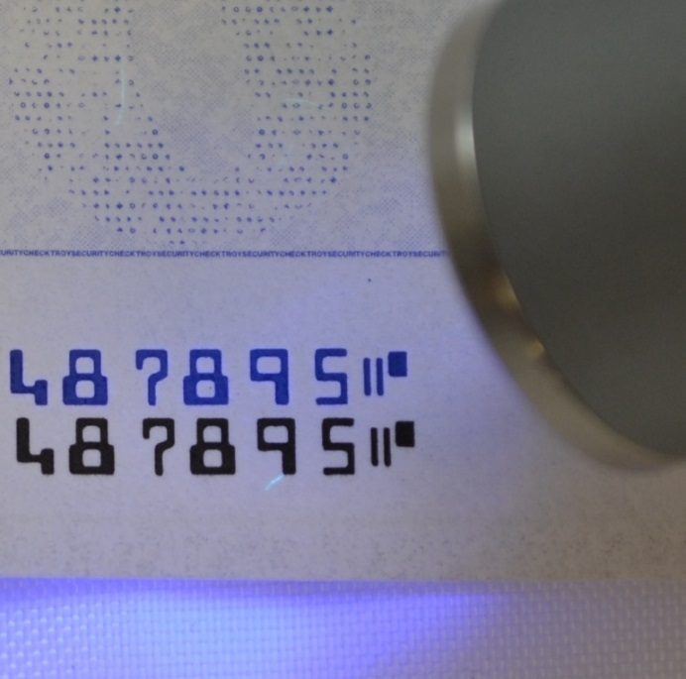
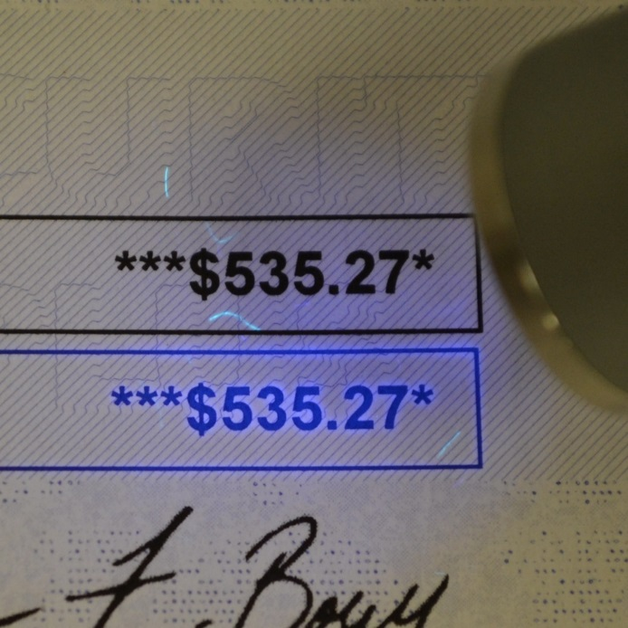
TROY UV Toner
TROY UV MICR Toner
TROY UV MICR Toner provides a secure method of authentication
TROY MICR Toner quality exceeds all cheque printing standards
Cartridges are precision-matched to meet the print characteristics of each print engine
The UV MICR Toner fluoresces blue under a UV verification light for easy authentication

Slide 12
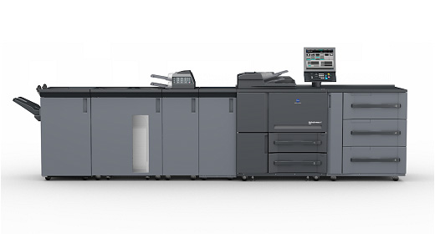
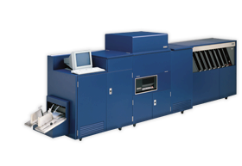
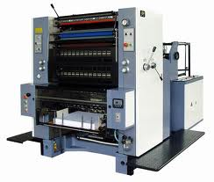
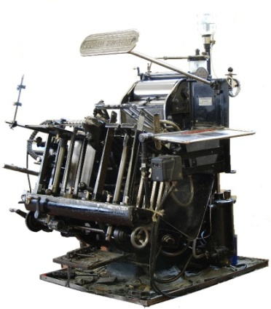
Evolution of Production MICR Printing Technologies
Offset Press and Letterpress (wet ink)
  ...Limited by inconsistent MICR readability
Impact Ribbon encoders (drum and hammer)
  ...Limited by speed, flexibility and print quality - now being phased out
Non impact ‘Digital Laser’ printers (EBI, xerography, LED)
  ...originally faced quality issues (at 300dpi) and toner adhesion challenges. Both now addressed with increased print resolutions and improved methods of fusing using pressure and heat.
  Digital is right choice for cheque personalisation!
TROY 6136 MICR Press
The TROY KM 6136P is a co-developed print production solution that relies heavily on TROY’s 63 years of patent experience and manufacturing capability. TROY invests in continuous R&D to ensure current and future customers have the best MICR print engine available.

Slide 13


SecureDocs

Slide 14
Point of issue Security
Security is about layers…
Document security is a combination of paper, pre-print, and personalisation…
Securing vital records at the point of issue through enhanced personalisation techniques ensures that stolen base-stock does not provide the criminal with an authentic document!

Slide 15
Document Security: Layers
Document Security Layers
Track& Trace
Base Stationery
Pre-Printed Security Inks
Paper/Substrate
Personalization
Verification
Identify & Locate
Authenticate
Variable / Personalized Data
Special Ink / Static MP
Static UV Logo
Base Stock

Slide 16

Document Security: Layers
Document Security Layers
Track& Trace
Base Stationery
Pre-Printed Security Inks
Paper/Substrate
Personalization
Verification
Identify & Locate
Point of Issuance /
On-Demand
Security
Authenticate
Variable / Personalized Data
Special Ink / Static MP
Static UV Logo
Base Stock

Slide 17


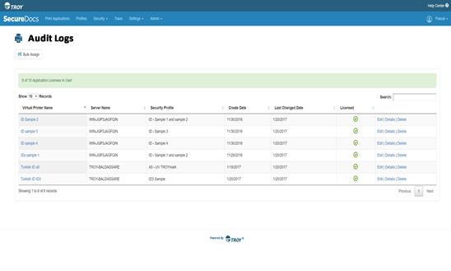
Print Trace – Tagging
John Doe 12/15/2016 3:31 UTC 162.45.354
Smart serialization tags allow real-time marking enabling a subsequent audit via the use of third-party solutions.
For example: Exploitation of the metadata generated for the constitution of a database.
Sample Use Case:
To help with regulatory compliance enforcement, insurance company prints job metadata tag onto special forms containing personal health information
John Doe 12/15/2016 3:31 UTC 162.45.354 Troysys/jdoe ID 11456 John Doe 12/15/2016 3:31 UTC 162.45.354 Troysys/jdoe ID 11456 John Doe 12/15/2016 3:31 UTC 162.45.354 Troysys/jdoe ID 11456 John Doe 12/15/2016 3:31 UTC 162.45.354 Troysys/jdoe ID 11456 John Doe
John Doe 12/15/2016 3:31
UTC 162.45.354
1108985

Slide 18
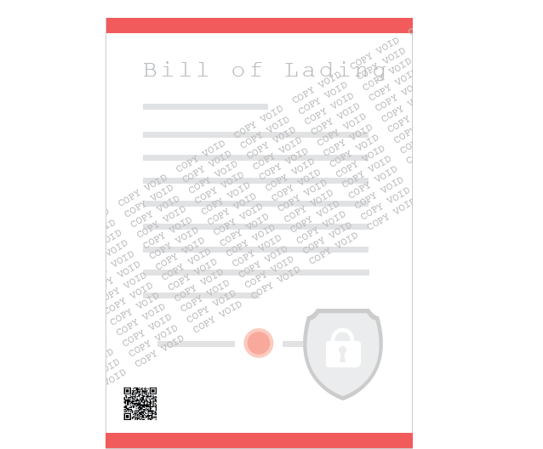
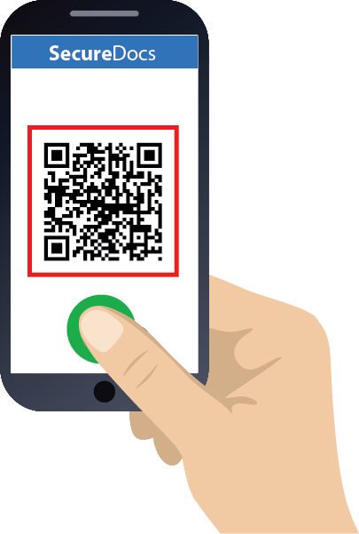
SecureMark: Mobile Document Verification
SecureMark allows you to add a high density encrypted QR code for offline digital authentication and verification of key data.

Slide 19
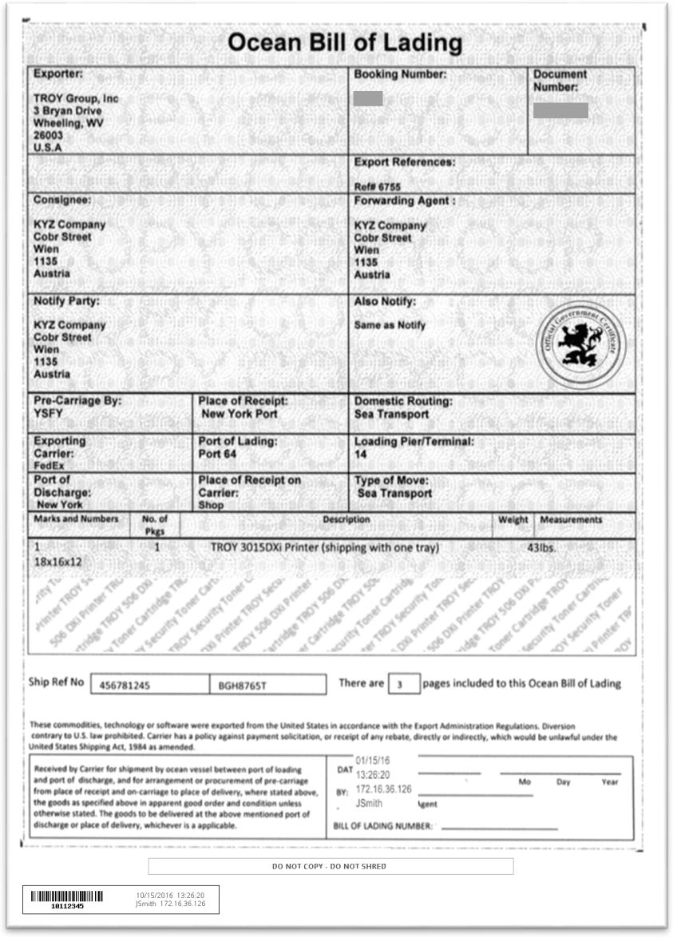

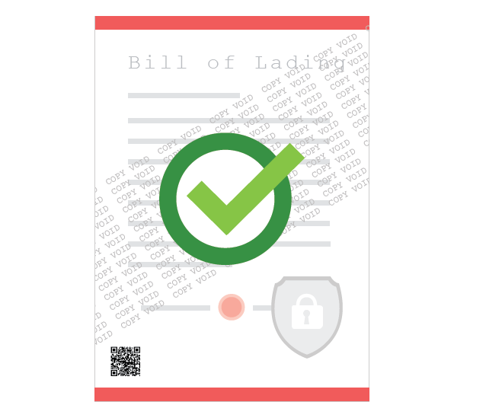
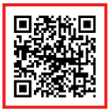
SecureMark: Key Features
Verify up to 1K of Sensitive Data
SecureMark can capture up to 1000 characters during printing. Data is embedded in secure QR code at the time of print.
Offline Verification
SecureDocs Document Verification uses a mobile app to verify sensitive information easily and securely. All data is stored in the code so can be verified without a connection.
Document Verified!
Invoice No: 1245
Date: 11/15/2016
Shipping Port: New York
Encrypted, Secure Code
SecureMark propriety Code is encrypted via Private/Public Key Hash that prevents unauthorized scanning of the code and makes it impossible to replicate or counterfeit
Real Time, Offline Mobile Verification with SecureDocs Mobile App

Slide 20
Automated Redaction and Digital Verification
Redact and Secure Sensitive data in an Encrypted QR code
  SecureMark enables digital verification with a smart phone to quickly confirm the values on a document.
  Combined with redaction, sensitive data fields can be protected from view, and embedded into SecureMark codes retrievable with a scan.

Slide 21
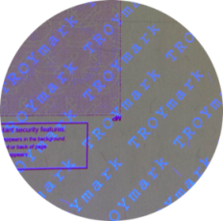
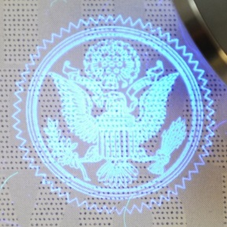
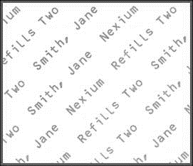
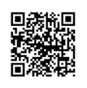
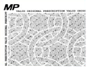

SecureDocs “on-demand” security elements
Variable-Data TROYMark™
TROYMark - unique watermark of variable data, printed diagonally across the document. Visible or invisible fluorescing UV Ink options
UV Ghost Image/Watermark
A Ghost Image creates an additional security layer by placing a secondary photo ID, or company seal, in SecureUV on the document
Secure Mark
A proprietary QR code is encrypted, via a
hashed algorithm, which prevents unauthorized users
from scanning the code and makes counterfeiting
impossible.
Print Trace
Smart serialization tagging allows for audit trail tracking and offline traceability. Each document (and page) is assigned a unique, non-sequential serial code which contains important information about each print job, including who, when, and where a document was printed.
Variable MicroPrint
Copy Prevention Pantograph
A copy preventation security layer, MicroPrinting
requires loop magnification to read and will become
illegible after photocopying. Injecting variable data into traditional MicroPrint further increases document security against fraudulent alteration
Prevent unauthorized copying, a Pantograph is a copy-evident feature which gives a user-defined security message, such as Copy or Void on the photocopied or scanned duplicate.

Slide 22

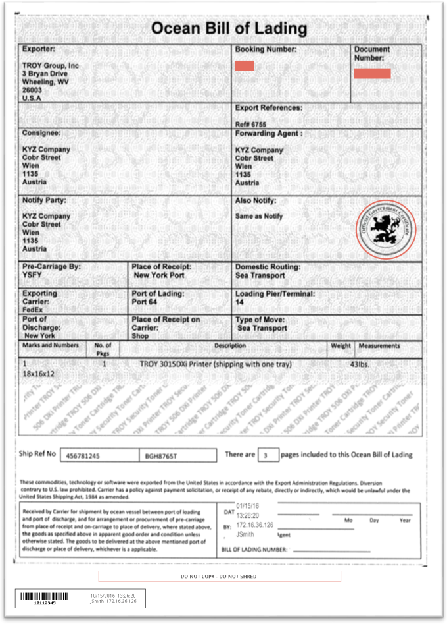
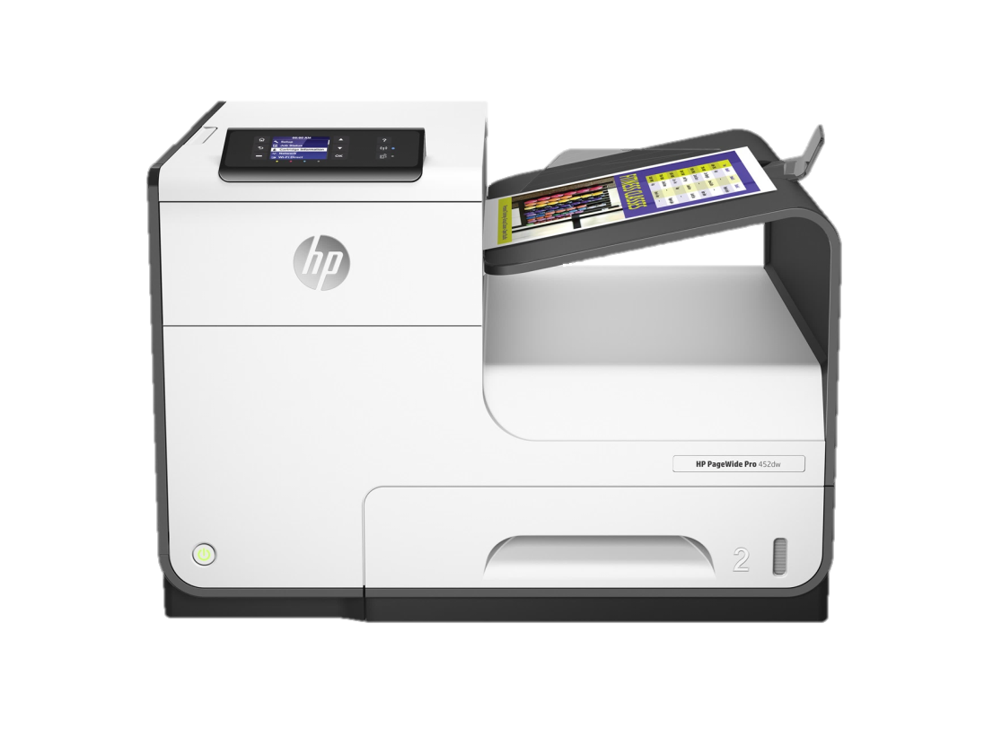
SecureDocs extends document security to the personalisation
TROY SecureDocs is a software solution designed to add personalized, on demand, layered security to each document at the point of issue to increase security of important documents and sensitive data.
Document Verified!
Invoice No: 1245
Date: 11/15/2016
Shipping Port: New York

Slide 23
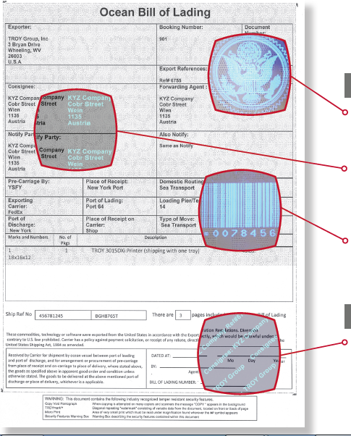
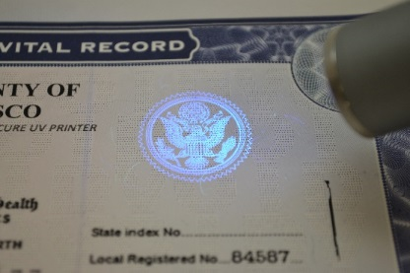
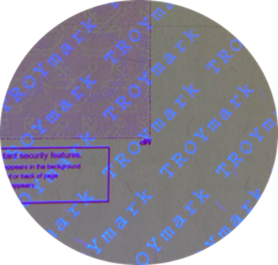
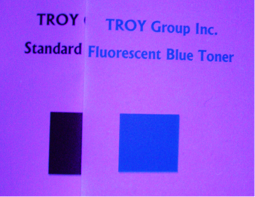
TROY Secure UV Inks
Ultra-Violet (Invisible) inks
Prints invisible and fluoresces blue under UV light
Utilizes Y cartridge to produce UV Print
Vital Record
Fluorescing Black inks

Slide 24

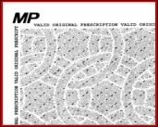
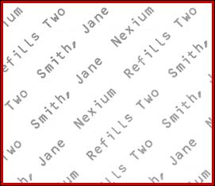

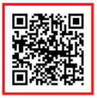
Next generation secure “Smart” document
Anti-Copy Prevention
Document Fingerprinting
Copy evident Pantographs or MicroPrinting to identify unauthorized copying
Automatically identified documents based on key attributes of the document. Apply security features based on documents that meet the fingerprint ID
Variable Text Watermarking - TROYMark
Optical Watermarking
A unique variable data watermark, printed diagonally across the document
Simple anti-copy watermark feature. Insert custom image or dynamically capture existing document logo or image
PrintTrace – Document Traceability
SecureMark - Digital Document Verification
Document verification adds a small encrypted QR code for offline digital authentication and verification a key data
Smart serialization tags allows tracking and traceability targeting risk mitigation and full audit trail reporting

Slide 25
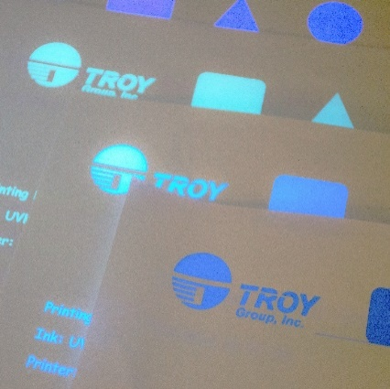

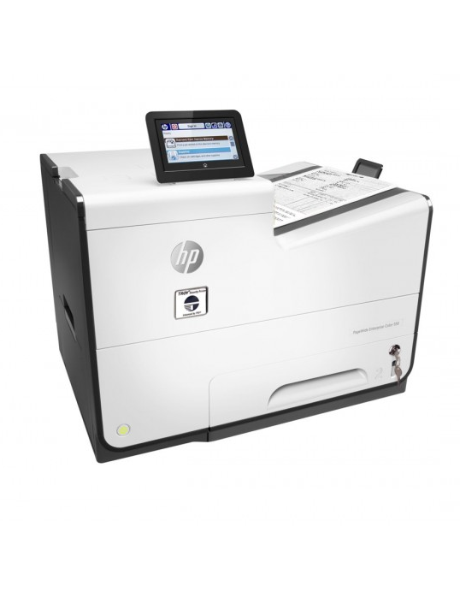
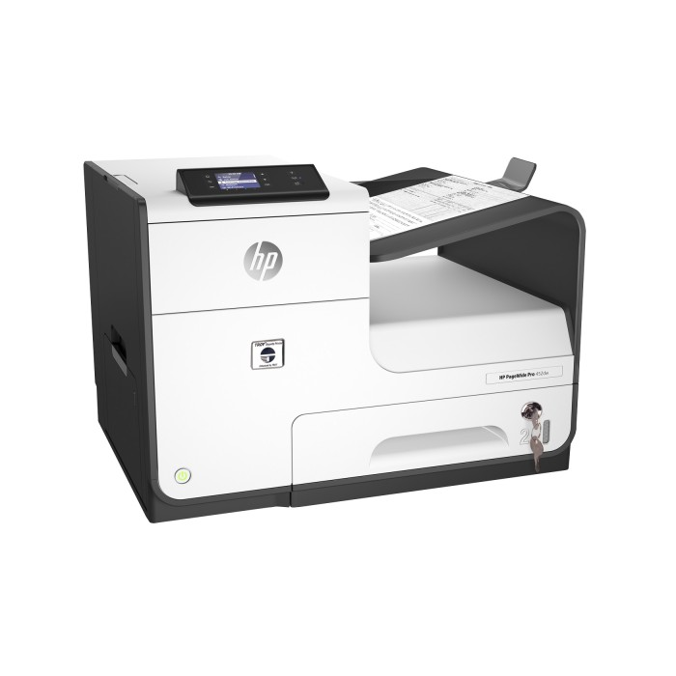
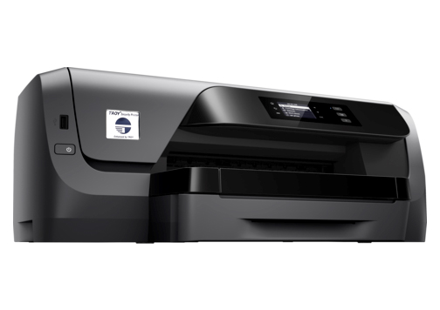
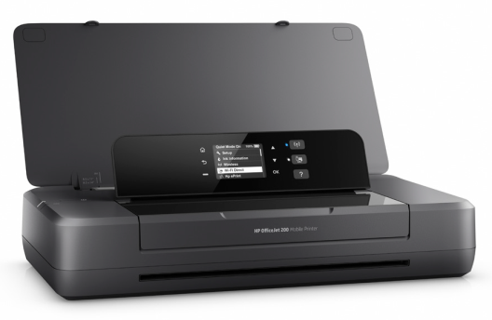
SecureUV Printers and Inks
PageWide SecureUV 556
Centralized Security Printing
75ppm
7,500 pages/month
PageWide SecureUV 452
Centralized /
De-centralized Security Printing
55ppm
4,500 pages/month
SecureUV OfficeJet 8210
De-centralized Security Printing
22ppm
1,500 pages/month
Mobile SecureUV 200
Remote/Mobile Security Printing
20ppm
1,500 pages/month

Slide 26
TROY Value Proposition
The Opportunity:
A security document is not secure until the variable data on the document is secure.
Majority of document fraud occurs by attacking the personalised data by changing names, dates, serial numbers, monetary value etc.
Securing the personalisation at point-of-issue prevents genuine stationery being stolen and personalised by fraudsters on standard desktop printers.
Additional layer of security at point of issue removes risk of stolen stationery
Increases integrity and value to the customer with additional security at the point of issue
Notes:
Mission: reach US sales volumes in 3 years. Means go from $4.2M to $50M and that’s 100% growth year over year. Growth is intentional, does not happen automatically.

Slide 27
Documents we can help Secure
Vital Records (Birth, Marriage, Death, Divorce certificates)
Registration documents (vehicle, gun, boat, aircraft..)
Certificates of Compliance / Authenticity / Manufacture
Land Registry / Title Deeds
Tax Banderoles / Tax Receipts
ID Cards / Temporary ID documents
Food Vouchers and certification (organic etc)
Diplomas and Exam Certificates
Medical Prescriptions
Licenses, Permits
Legal documents / contracts
Insurance Documents

Slide 28

Pandemic specific opportunities we can help Secure
Employer Certificate confirming employee status for vital workers
Certificate of vaccination
Certificate of immunity
Medical Prescriptions
Licenses, Permits

Slide 29
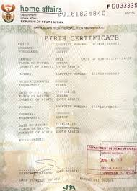

Vital Records: East Africa
Vital Records (Birth, Marriage, Death)
  130 locations
  Birth, Marriage and Death Certificates
  TROY Solution: 200 UV Printers and Securedocs Licenses
  QR code, Serialization
  MicroPrint and TROYmark
  Ghost image, UV inks
  $1.3M deal

Slide 30
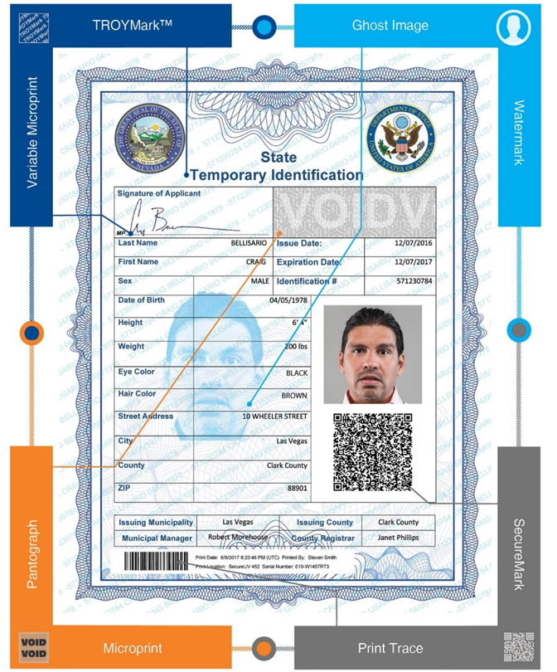
Temporary ID (South-Eastern Europe)
Temporary ID
  1000 Civil Registration locations
  Temporary replacement for lost / damaged cards and newborn
  TROY Solution: 1,350 x 8210 UV Printers and SD Licenses
  QR code and Serialization
  MicroPrint and TROYmark
  Ghost image, UV inks

Slide 31
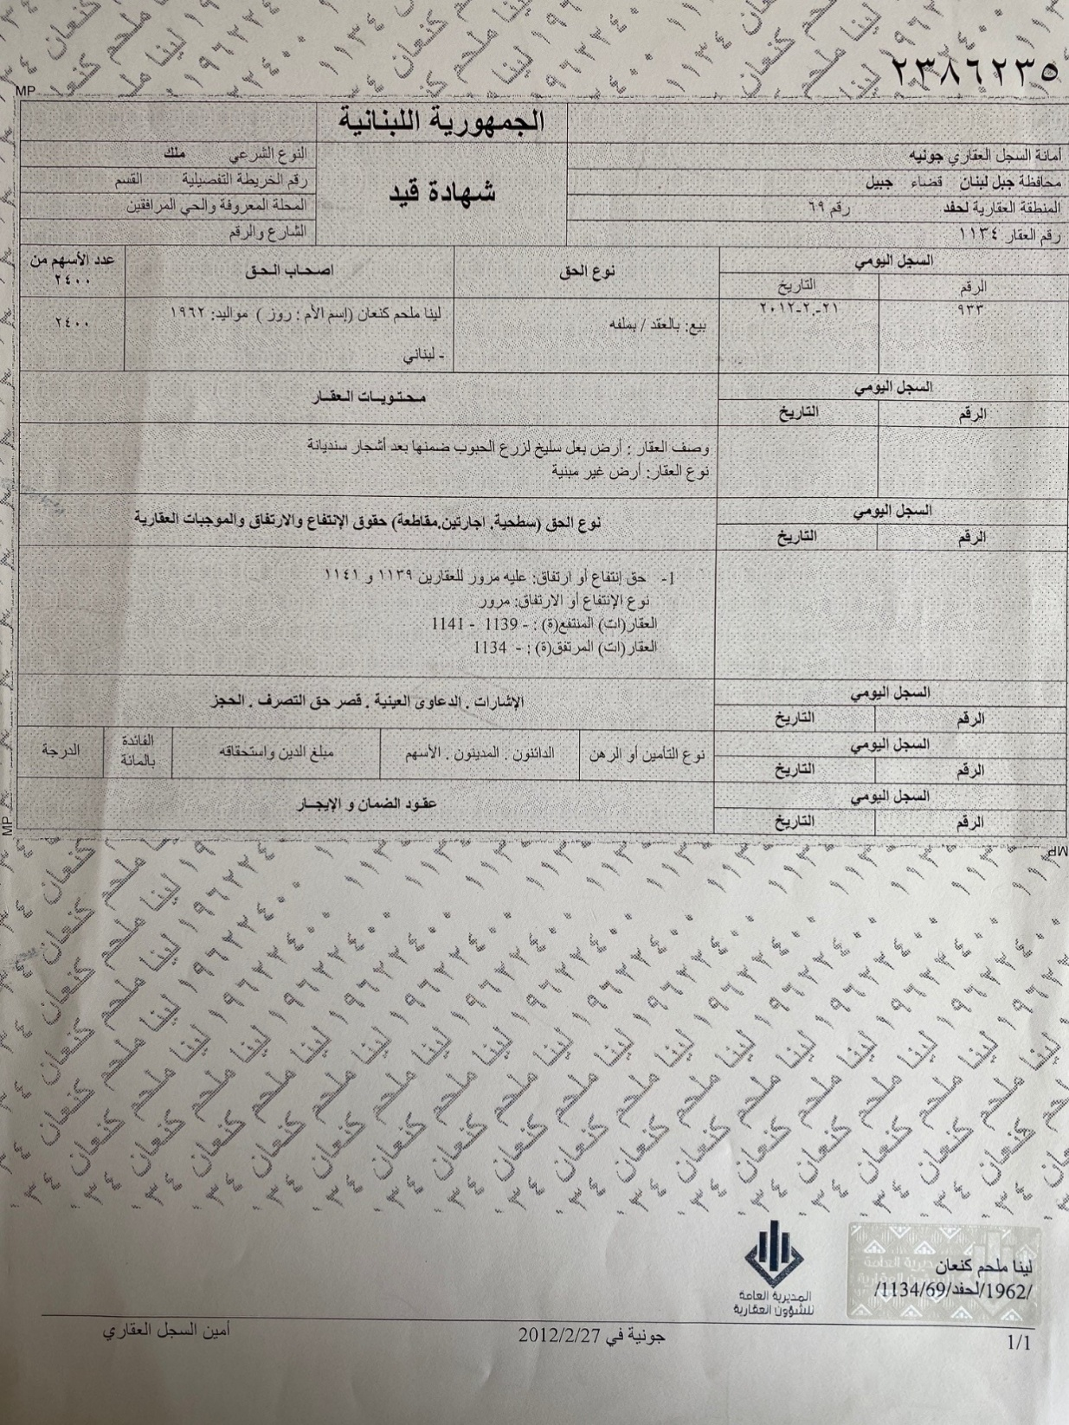
Land Registry: Arabic

Slide 32
What will TROY provide?
Consultancy from an experienced team
Data handling software for secure personalisation and authentication
Secure personalisation printers with Ultra-Violet fluorescing inks
Central, Regional or decentralised document personalisation
Support and maintenance arrangements through a local Distributor
Verification tools for authentication
Successful project delivery

Slide 33


