Slide 1



Presentation
CONFIDENTIAL AND PROPRIETARY ALL RIGHTS RESERVED

Slide 2
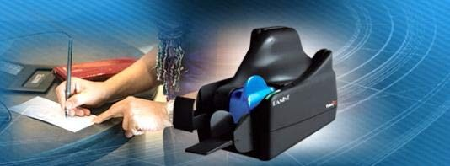
Core Business
Panini is a trusted global leader in providing payment technology innovation.
Our check and document capture solutions for the financial and payments industry contribute to improved process efficiency, user productivity and effectiveness of business relations for our customers and partners.
Our ambition is to support the growth and change of our customers – banks, post offices and businesses – by making available our experience, international presence, innovation capability and service quality.
CONFIDENTIAL AND PROPRIETARY ALL RIGHTS RESERVED

Slide 3

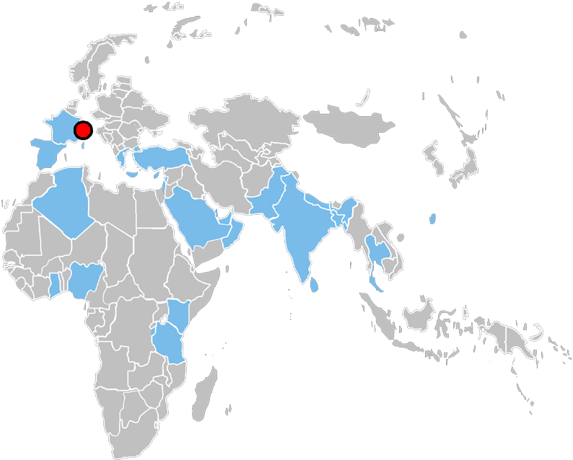















International Coverage
Torino, Italy Dayton, USA
(HQ)
São Paulo, Brazil
CONFIDENTIAL AND PROPRIETARY ALL RIGHTS RESERVED

Slide 4


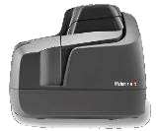
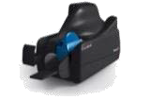

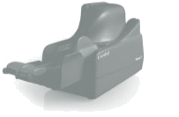

Key Applications: Teller or Branch Image Capture
Branch Server
Teller Stations with Capture Device
teller / branch applications
Image scan & capture device at each station
CAR/LAR, POD, item endorse
Signature / account verification
Back counter station
Shared image capture device connected on network to branch server.
Items are processed at the teller or at the back counter according to volume of items, bank’s strategy and regulations.
Central Server

Slide 5



Key Applications: Remote Deposit Capture
Corporate or Small Business Client
On-site device/software to convert Accounts Receivable to ACH electronic transactions and/or digital images.
Bank Server
Client Capture Device
Ideal for commercial accounts to reduce processing time and errors while improving funds availability.
[Client Server]

Slide 6
Panini scanners beyond check processing
MICR, OCR and barcode decoding
Single line or multiple line (AGP line) printing
Compatibility with documents up to 330 mm x 105 mm (A6 height)
Auto-adaptation to different paper qualities and thicknesses
2 pockets for physical sorting when needed
Examples of non-check usage:
MEAL VOUCHERS POSTAL
BILLS POSTCARDS LOTTERY TICKETS
…

Slide 7
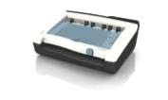




Example of Vertical Application (Healthcare Claims)
Claim submitted
Healthcare Provider
Healthcare Payer
Health card
EOB and payment
Patient
Co-pay
Co-pay and reimbursement checks deposited via RDC
Bank

Slide 8
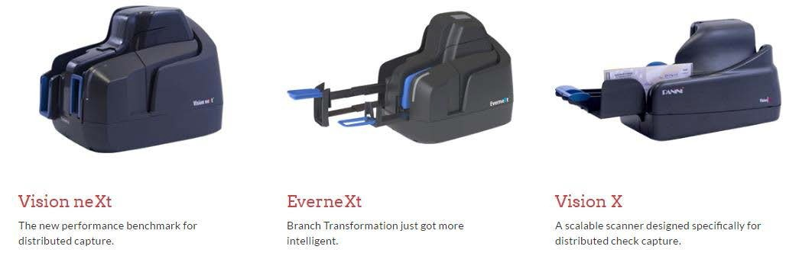
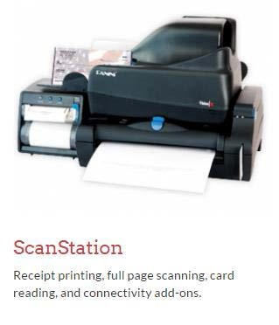
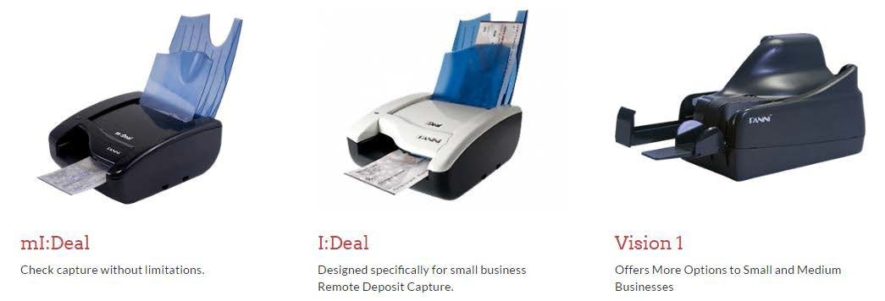
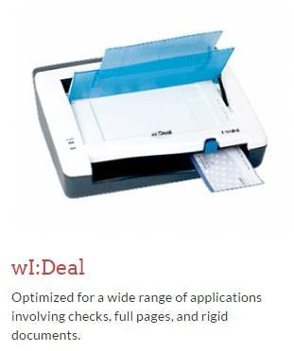
Panini scanners range

Slide 9
Panini scanners features comparison table
Maximum throughput (documents per minute) | Vision neXt 160 | EverneXt 160 | Vision X 125 | Vision X AGP 125 | Vision X P 100 | Vision 1 manual* | I:Deal manual | mI:Deal manual | wI:Deal manual
Greyscale or bitonal (B/W) imaging, front & rear |  |  |  |  |  |  |  |  | 
Color imaging, front & rear |  |  |  |  |  |  |  |  | 
MICR decoding (CMC7, E13B) |  |  |  |  |  |  |  |  | 
OCR decoding (OCR-A, OCR-B) |  |  |  |  |  |  |  |  | 
1D Barcode decoding |  |  |  |  |  |  |  |  | 
2D Barcode decoding (Datamatrix, PDF 417) |  |  |  |  |  |  |  |  | 
Image Quality Assurance (IQA) library |  |  |  |  |  |  |  |  | 
1 line ink jet rear printer |  |  |  |  |  |  |  |  | 
AGP IJ rear printer (up to 4 lines and/or graphics) |  |  |  |  | 
AGP14 IJ rear printer (up to 14 lines in 4 passes) |  | 
Dual pocket | exception pocket | exception pocket |  |  |  | feeder | feeder | feeder | feeder
Virtual Endorsement |  |  |  |  |  |  |  |  | 
Front franking stamp |  |  |  |  |  |  |  |  | 
Thermal receipt printer | MFS |  | MFS | MFS | MFS | MFS
Full page/A4 scanning |  |  | MFS | MFS | MFS | MFS |  |  | 
Rigid document (ID card) scanning |  |  | MFS | MFS | MFS | MFS |  |  | 
Magnetic card reader |  |  |  |  |  | 
Smart (chip) card reader |  |  | MFS | MFS | MFS | MFS
Host Type | Windows PC | Win PC, Mac, tablet, smartphone | Windows PC or Mac | Windows PC or Mac | Windows PC or Mac | Windows PC or Mac | Windows PC or Mac | Win PC, Mac, tablet, smartphone, POS terminal | Windows PC
 = included
 = optional
MFS = requires add-on hardware module
* = not upgradable to batch feed

Slide 10
Multi-Function Options summary table
 | Vision X | Vision neXt
AGP ink jet rear printer (up to 4 lines and/or graphics) for cut sheet receipts | (Vision X AGP or P) | 
AGP 14 ink jet rear printer (up to 14 lines in 3 stripes) for cut sheet receipts, cashier’s check |  | 
Dual pocket for real-time sorting of exceptions | (Vision X P) | Exception Pocket
MFS thermal Receipt Printer (unified power+USB cable, requires MFS d.s.) | 
Stand-alone thermal Receipt Printer (with autonomous power supply) |  | 
MFS Hub docking station with 3 USB ports | 
MFS-A4 (full page/A4 scanning) docking station | 
Inset 3-port USB hub |  | 
Rigid document (ID card) scanning | (MFS d.s.) | 
Magnetic card reader |  | (CM)
Smart (chip) card reader | (MFS d.s.) | (CM)
 = included
 = optional
MFS d.s. = requires add-on docking station hardware module (MFS hub or MFS-A4) CM = requires add-on card readers hardware module

Slide 11
Thank you!

