Slide 1

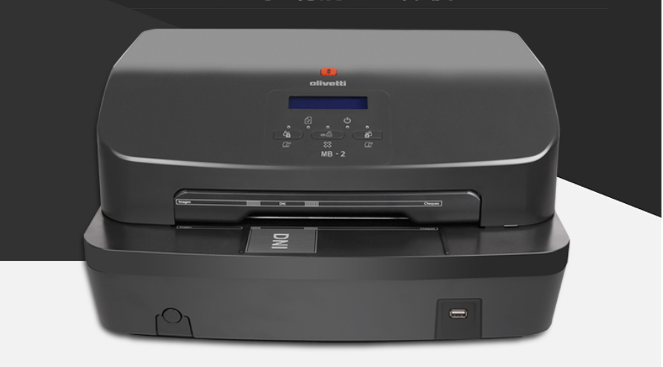
Multifunctional printer
-Bank Teller & Self-service All-In-One application

Slide 2
Agenda
Banking teller: reference scenario
Product for digitization and document management:
  Multifunctional Banking:
    Features and specifications
    Main uses of the scanning features at the teller
  Dual color printing
  Kiosk solutions
Installation Reference

Slide 3
Reference scenario (focused on Banks)
Search for efficiency
Reorganisation of operational processes
Reduction of paper; efficient document management
Competition pressure and
cost reductions
Bank branch reorganisation
Transformation of portion of bank counters into consultancy advice desks (“from teller to seller”)
Low added-value operations handled without involvement of staff
Relationship with Customers and increase in rate of introduction of new products
Better communications and interaction with Customers within the Branch
Reduction of time-to-market by reorganising distribution process for information material

Slide 4
Agenda
Product for digitization and document management:
  Multifunctional Banking:
    Features and specifications
    Main uses of the scanning features at the teller
  Dual color printing
  Kiosk solutions
Installation Reference
Banking teller: reference scenario

Slide 5

Password to the future: paperless!
Dematerialisation of documents at the counter
Solutions to manage scanned documents (document HUB)
Legal value of the acquired images (i.e. cheque imaging) and process review to limit the paper circulation

Slide 6










The evolution in Cheque Management (1/2)
Traditional Cheque Clearing
More than 4 DAYS
Beneficiary account
Issuer account
Bank A
Bank B
Beneficiary
Bank A Clearance
Exchange center
DON’T PAY

Slide 7





Electronic Cheque Clearing procedure
The evolution in Cheque Management (2/2)
1 DAY
Beneficiary account
Issuer account
Beneficiary
Bank A
ELECTRON
Exchange
Bank B
NIC
center
ELEC

Slide 8
Password to the future: paperless!
Dematerialisation of documents at the counter
Solutions to manage scanned documents (document HUB)
Legal value of the acquired images (i.e. cheque imaging) and process review to limit the paper circulation
Growing demand for scanning functionality in Banks
“All-in-one” to manage the whole cycle of printing and scanning:
For customers not interested in “all-in-one” solution, we’re introducing in our offer a
MB2 & MB-2 ADF
SPECIALIZED SCANNER

Slide 9
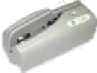




Document Management at the teller
The evolution of the teller activities is oriented to optimize the generation / digitization of various types of documents:
Growing need for various formats scanning: identity documents (including ID card), slips, checks, up to A4
Printing of receipts, endorsement, special documents (eg checks)
An important aspect in this development is the choice between specialized devices and multifunctional products that merge the different functionalities
Desktop Scanner and/or check reader
Barcode reader
Banking Printer
Banks are more and more oriented towards a teller device rationalization,
aiming to converge on a single device the printing and scanning / reading functions.
Multifunctional
Banking device

Slide 10
Agenda
Product for digitization and document management:
  Multifunctional Banking:
    Features and specifications
    Main uses of the scanning features at the teller
  Dual color printing
  Kiosk solutions
Installation Reference
Banking teller: reference scenario

Slide 11
MB – 2 Today
The Multifunctional Banking MB-2 is the PR2 evolution: it combines all the PR2 printing features with the reading / scanning functionalities, to manage all types of documents in use at banks branches.
Main features
Multiple sheets document printing
Passbook
and magnetic stripe management
Concurrent double face color document scanner
The MB-2 has already been adopted by major Spanish banks (La Caixa, Banco Sabadell, Banco Popular, Ibercaja) and by Banca Popolare Pugliese (Italy), Poste Italiane, Agriculture Bank of China, etc
One pass OCR/OCR-B recognition of multiple fields
ID card handling, also in credit card format
Advantages
Barcode Recognition
Lower TCO:
Lower total cost of purchase
Lower cost of service
Lower power consumption
MICR Reading (CMC7 and E13B)
Cheque endorsement
Reduced space requirements: the MB-2 maintains exactly the PR2 dimensions
Integrated 3 ports HUB USB
•
Ease and "familiarity" of use
UV light（OPTIONAL）-Enable scans of security festures

Slide 12





Main Features
High definition (600 dpi) colour scanner model Both side capture (front and rear in one pass) 600 dpi, 24 bit colour, 256 gray levels
UV CIS (optional)
Speed: (VHSD@10cpi)
higher head’s shoot frequency to reach 560 cps or 370 cps in draft@10 cpi
Throughput:
560 pph (Bank document 210x240, HSD) 370 pph (Bank document 210x240, NLQ) 305 pph (ECMA letter, HSD)
Serial, USB and centronics interfaces always mounted on all models; Three USB ports added to teller
Display for a better usability
Specially designed for ID Cards

Slide 13
Printing specifications (1/2)
MB-2
Dot Matrix technology
24 needles printhead
Resolution 240 x 360 dpi
Printing width 238,76 mm (94 columnas a 10 cpi)
》 Line space 1/5", 1/6", n/216", n/240"
Speed:
  560 cps (VHSD) o 510 cps (HSD) o 370 cps (draft) o 185 cps (NLQ) o 125 cps (LQ)
2000 dps in BIM mode (bits image mode)
Throughtput:
  560 pph (banking document 210x240, HSD) o 370 pph (banking document 210x240, NLQ) o 305 pph (ECMA letter, HSD)
Fonts OCR A-B, ROMAN, Sans Serif, Italic and Courier
Densities of 10, 12, 15, 16,6 and 17,1 cpi

Slide 14
Printing specifications (2/2)
MB-2
Print documents and passbook.
Automatic print positioning based on sheet-edge position (auto-border)
Passbook insertion in any position – automatic positioning of printing
Automatic alignment of sheet at insertion
Passbook management:
o o o
Automatic adjustment of contrast bar to document thickness Optimized movements
Horizontal magnetic stripe
MICR Reading (autorecognition of CMC7 and E13B) with concurrent endorsement
Special padding to reduce noise: less than 54 dB (ISO 7779 test)
Max paper width: 245 mm.
Multiple copies: original + 6 copies
Standard Olivetti commands
Dimensions: 384 x 296 x 204 mm.
Weigth: 10,5 Kg.

Slide 15
Scanning features
MB-2
600/300/200 dpi CIS Scanner
Image capturing
Black and White, 16 or 256 Grey levels
2/4/8 bit/pixel gray scale acquisition
24 bit/pixel Full Color acquisition
Scanning speed: 10 inch/s, 3,3 inch/s in full color
Concurrent scanning (front and rear in one pass)
Up to A4 wide documents
Interfaces & Ports
USB 2.0 HS & Centronics ECP Interfaces
Dedicated PCB with internal USB HUB
Software
Brightness and contrast software controlled
BMP original format; JPEG/TIFF through DLL conversion
Recognition software on Windows PC: OCR B, Barcodes
TWAIN Driver

Slide 16
Interfaces & Ports
MB-2
USB 2.0
  Self-powered
  Bus current 0 mA
  Transfer rate 480 Mbps o Type B Connector
Serial o
o o o o o o o
EIA RS-232C Asynchronous Handshake XON/XOFF and DTR/DSR 9 wire canon male connector
Bit/s: 1200 / 2400 / 4800 / 9600 / 19200 / 38400 / 115200
7 and 8 data bits
Parity: Odd / Even / None Stop bit(s) 1 / 2
Configurable by peripheral setup or by PC application
Parallel port
o o o o o
IEEE 1284
Female centronics connector 36 wire Bidirectional
SPP / ECP / byte Mode Speed: 120 KB/s

Slide 17
Software environment
MB-2
》
All printing functions are plug and play compatible with PR2 plus
All scanner functions can be managed via standard TWAIN driver
All MICR reading functions are plug and play compatible with PR2 plus
》
》

Slide 18
Agenda
Product for digitization and document management:
  Multifunctional Banking:
    Features and specifications
    Main uses of the scanning features at the teller
  Dual color printing
  Kiosk solutions
Installation Reference
Banking teller: reference scenario

Slide 19
Cheque management
Main scanning uses
The MB-2 allows to manage the whole “cheque cycle”:
delivering of a new cheque book, printing the customer data
issuing of a cashier's check, writing amount, date, beneficiary
single pass management of a cashed cheque
  reading: the magnetic head allows to read the “codeline” of
cheques, to acquire the cheque’s data
  endorsing: printing of the endorsement data on the cheque
  scanning: acquiring of the cheque image, after the endorsement

Slide 20
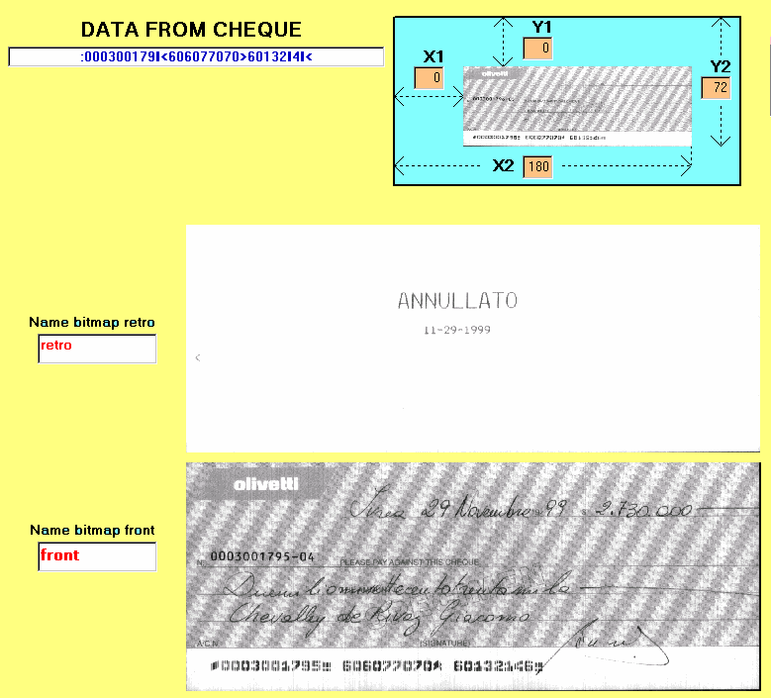
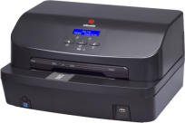
Main scanning uses
Cheque image acquiring and reading
The MB-2 series allow the cheque front/rear image acquiring and the codeline reading (E13B and CMC7 standards) both with Magnetic and Optical reading, to guarantee a complete and effective data recognizing.

Slide 21
Main scanning uses
Cheque/banknote fraud detection
U.V. and I.R. detection（OPTIONAL）-Enable scans of security features
With the increasing use of UV and IR ink on cheques and banknotes in a worldwide range, a simple physical verification of each check or banknote is no longer sufficient and effective in today’s financial environment. MB2 offers the option of security scanning to improve the level of their customer’s fraud detection while maintaining check/banknote processing efficiency.
With an integrated CIS for both ultraviolet (UV) and infrared (IR) light, the critical areas on the cheques/banknote, such as the signature box, code line, payable amount and bank logo can be scanned in a single pass to immediately identify a fraudulent one.
As both UV and IR are not visible to the human eye, special software will be also provided to image these inks into the visible spectrum.

Slide 22
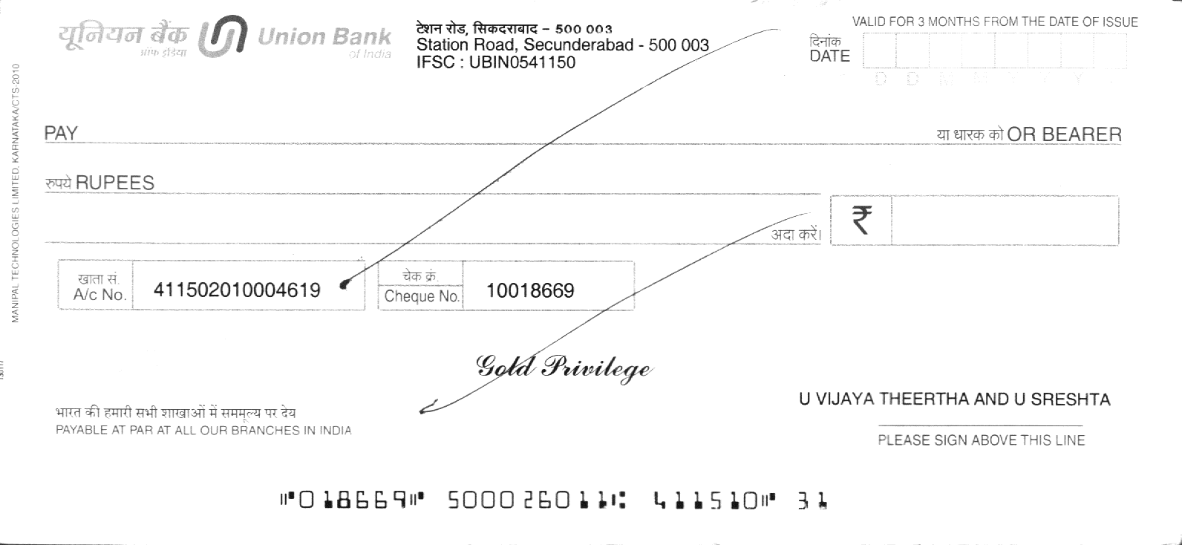
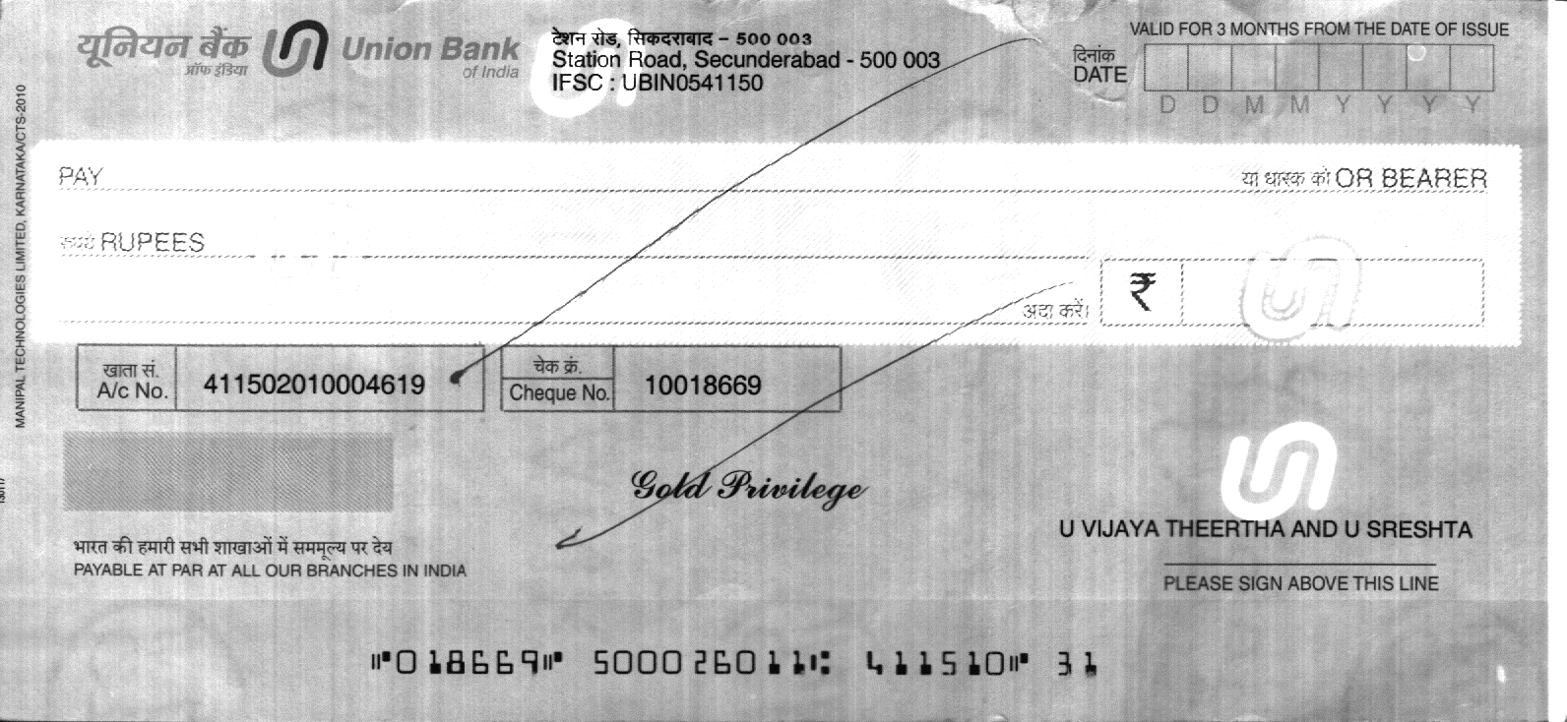
Main scanning uses
Cheque image quality
Normal Image
UV Image

Slide 23

Cheque endorsement
Main scanning uses
MB-2 series allow a one-pass complete cheque endorsement, with several lines printing.

Slide 24
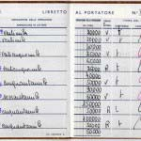
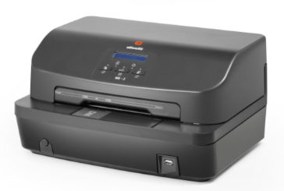
Passbook management
Scanning uses
MB-2 allows complete management of a banking passbook:
Magnetic stripe writing
Magnetic stripe updating
Printing on passbook pages for data updating
Scanning of passbook pages for client identifying and data capturing
The whole cycle of a passbook reading and updating can be managed in a single operation

Slide 25
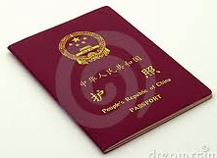
Passport scanning
Scanning uses
The MB-2 series allow also the Front-Rear passport scanning, giving the possibility to manage directly at the teller all the possible Identity Documents.
The 1-pass Front-Rear scanning of thick documents like passport is a special and uncommon feature; tipically, to scan these documents it’s necessary to use flatbed scanner, with two separate scans.

Slide 26




ID Cards: customer’s data capture
Scanning uses
MB-2 was specifically designed to manage all plastic cards (Credit Cards, Badges, Identity Cards, etc.).
Scanning the electronic identity cards allows the automatic data capture and immediate customers identification
Images Data
NAME SURNAME
AGE
01 05 1972
CODE 99999999 R
ADDRESS CITY
PAGE 16 PAGE *

Slide 27
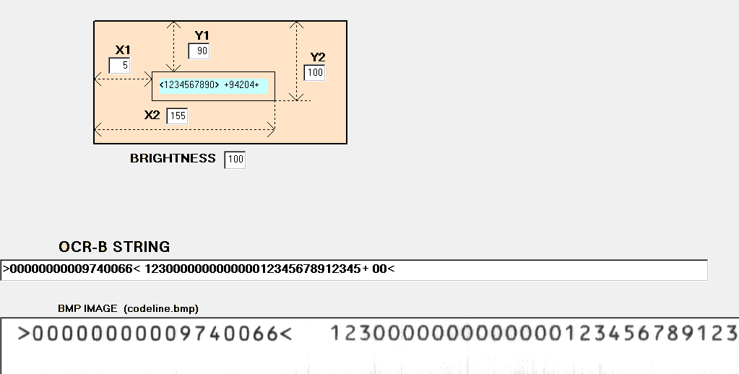
Characters recognition (OCR, OCR-B, …)
Scanning uses
The Optical Characters Recognition allows the automatic reading of codes printed on several forms (cheques, bulletins, vouchers, etc.), making faster data capturing and payment transactions

Slide 28



Barcode recognition
Scanning uses
Barcode recognition (included 2D barcode, like QR) allows to read information printed on several forms, products, labels, etc.
With an MB-2/Oliscan and a specific software, it’s possibile to read a barcode without a dedicated Barcode reader

Slide 29
Agenda
Product for digitization and document management:
  Multifunctional Banking:
    Features and specifications
    Main uses of the scanning features at the teller
  Dual color printing
  Kiosk solutions
Installation Reference
Banking teller: reference scenario

Slide 30
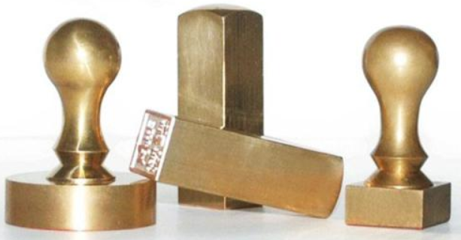
Problems in seals management
High management cost
--Too many physical seals.
--Mislaid of seals.
Legal risks
--Forgery of seals.
--Sealed without approval.
--No records to track.
Low efficiency
--Complicate administration procedures
--Seals dispersed in different places and managed by different people.

Slide 31
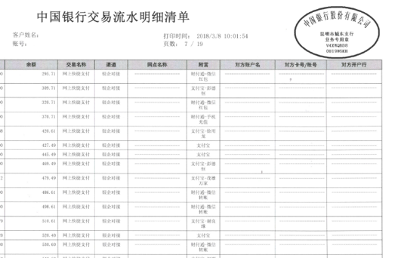
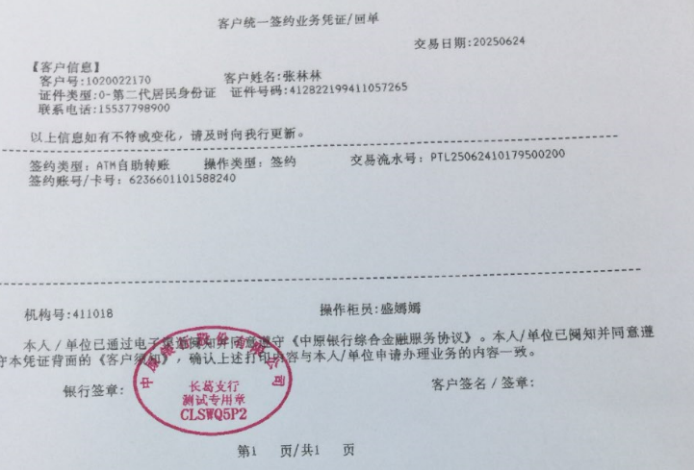
Dual color printing
As is
To be

Slide 32
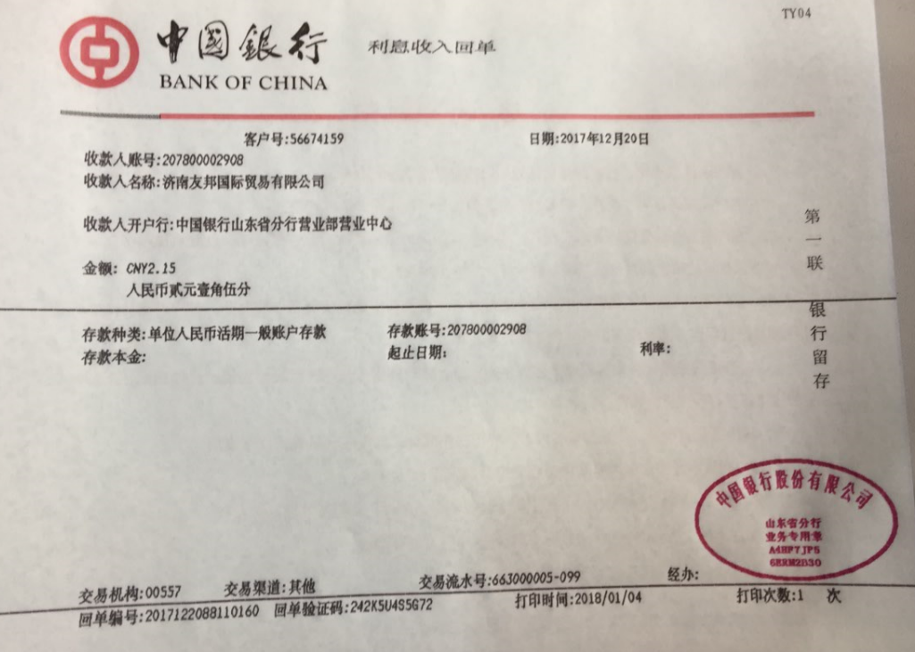
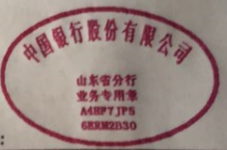
Dual color printing quality

Slide 33
Agenda
Product for digitization and document management:
  Multifunctional Banking:
    Features
    Main uses of the scanning features at the teller
  Dual color printing
  Kiosk solutions
Installation Reference
Banking teller: reference scenario

Slide 34
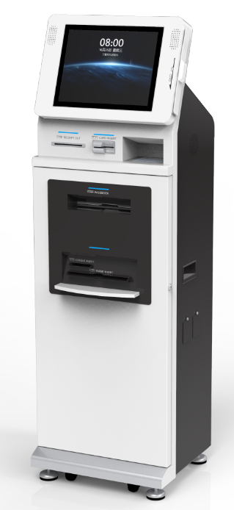
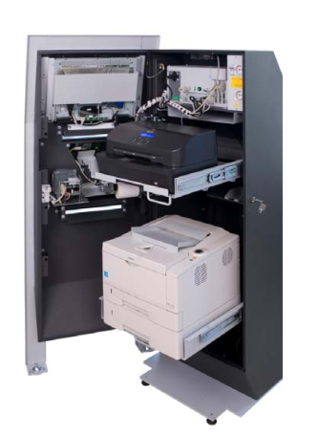
  Self-service passbook updating
MB2 in kiosk solutions
MB-2 can be integrated into Kiosk for passbook updating and check depositing (optional) ,which can process the passbook with barcode to update the passbook. If the application supports, it can be used to deposit checks (with UV and MICR recognition, paper feeding and recycling mechanism etc).
Models Developed

Slide 35
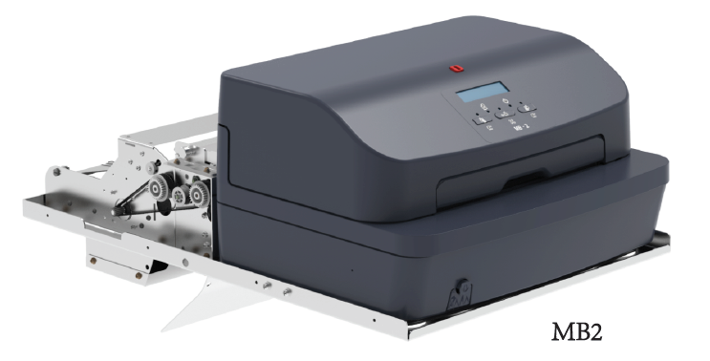
  Multifunctional Documents Feeding & Processing Module
MB2 in kiosk solutions
Based on MB2 advanced passbook printer，Olicom has launched the Multifunctional Documents Feeding & Processing Module which is capable to feed documents, receipts and cheques ranging from A5 size, A4 size from rear automatically to be managed the whole cycle of printing, scanning, MSR/MICR reading and archiving .
At the same time, the module can be equipped with a special retrieving channel to realize the collection of passbook, cheques, A5 size and A4 size printing media after printing and/or scanning inside kiosks.

Slide 36
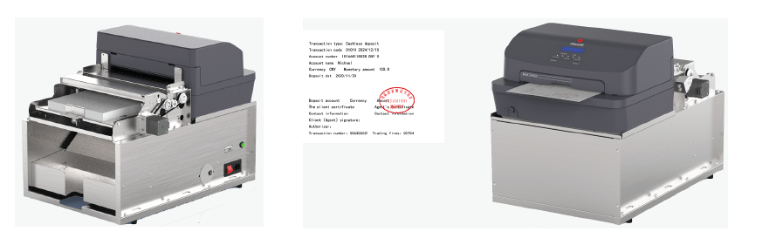
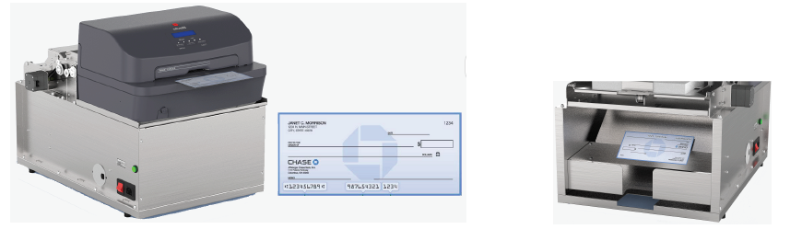
  Multifunctional Documents Feeding & Processing Module
MB2 in kiosk solutions
Receipts / Bills / Forms distribution - printing /scanning/stamping
Cheque processing and retrieving

Slide 37
Agenda
Product for digitization and document management:
  Multifunctional Banking:
    Features
    Main uses of the scanning features at the teller
  Dual color printing
  Kiosk solutions
Installation Reference
Banking teller: reference scenario

Slide 38




Installation references
Italian Post:
Print carbon paper 1+6 copies
Barcode scanning and OCR
Spanish banks:
Print carbon paper 1+6 copies
Passbook and magnetic stripe management
MICR reading and scanning, cheque imaging
ID card scanning and OCR recognition
Barcode scanning and reading
Unicredit Bank (Italy):
MICR reading and scanning, cheque imaging
Print carbon paper multiple copies
Seal reading and recognition
Total installed till 2019:
More than 280,000 machines
Italy small and medium banks:
Italian Post: India:
Spain:
Ibercaja (Spain)
Banco Sabadell (Spain) Banco Popular (Spain)
La Caixa (Spain)
Bawag (Austrian Posts) Czech Posts
Dutch Posts Hungarian Posts
around 120,000 machines
around 50,000 machines
around 20,000 machines, in which:
around 2,000 machines
around 3,000 machines
around 3,000 machines
around 4,000 machines
>3000 machines
>2000 machines
>2000 machines
>1600 machines
Print carbon paper 1+6 copies
Document scanning and imaging
MICR reading and scanning, cheque imaging
Barcode scanning and OCR
IS Bank (Turkey):
Print carbon paper 1+6 copies
ID card, driving license scanning and recognition
Czech Post Office:
Print carbon paper 1+6 copies
Barcode scanning and OCR
India:
Post Nord(Denmark+Sweden) >1500 machines
Passbook updating
Document processing
Transaction process and security control
Norwegian Post
small and medium banks
>1000 machines
>15,000 machines
China- ABC
>60,000 machines
China
Passbook and magnetic stripe management
Document processing
Transaction process and security control

Slide 39
User case
  IS Bank (Turkey):
    printing on multicopy (up to 6 copies)
    forms
    scanning to acquire the images from
    laminated ID documents and driving
    licences
Italian Post Office (specific Multifunctional PR2 model)
    printing on multicopy (up to 6 copies) forms
    OCR-B and Barcode reading on bulletins
  Czech Post Office:
    printing on multicopy (up to 6 copies) forms
    OCR-B and Barcode reading on bulletins

Slide 40
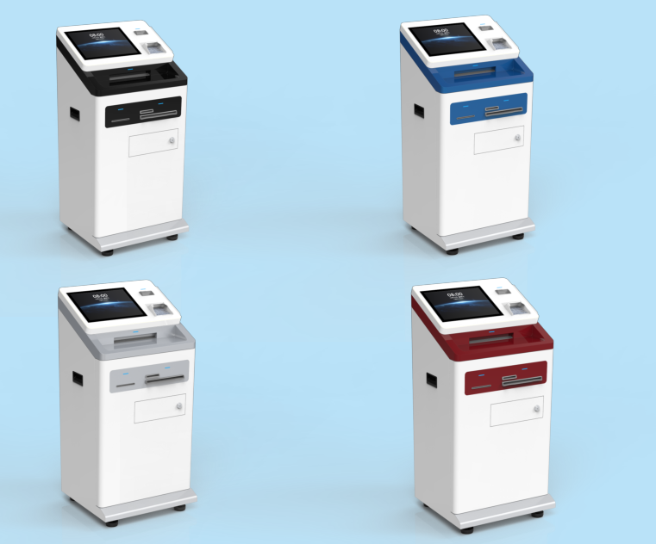
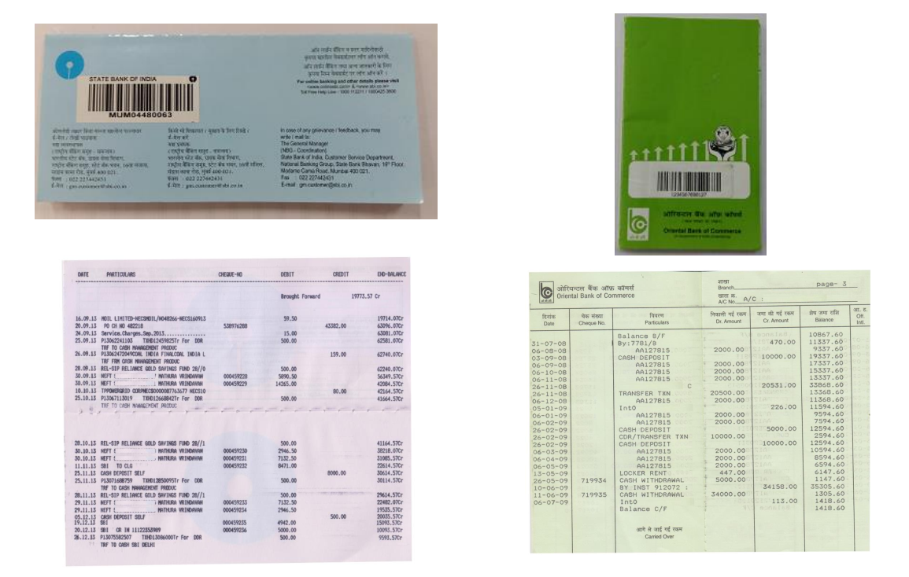
User case
Banks in India – Kiosk project
Installation reference
State Bank of India: 10000 units installed
Central Bank of India: 1000 units installed
Union Bank of India: 500 units installed
UCO Bank: 800 units installed
Allahabad Bank: 200 units installed
J&K Bank/Punjiab & Sind Bank/RBL…: > 3000 units installed
Main application:
Barcode mapping
First page printing
Pickup Passbook from Stack

Slide 41
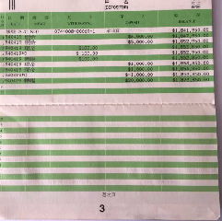
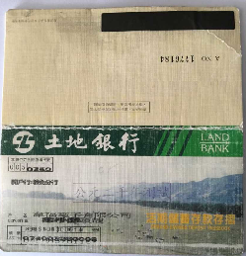
User case
Taiwan Land Bank – Passbook Updating （NCR Kiosk）
Magnetic stripe reading
Scanning
Page recognition/ Null recognition
Printing
HW：
MB2+ Magn. R/W+LCD+RS232+USB
SW：
Scanning API+ Barcode & page recognition + null recognition
Passbook upgrading

Slide 42
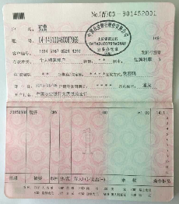
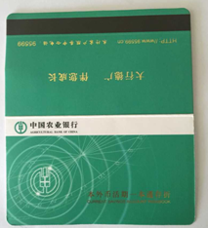
User case
Agricultural Bank of China – Security Control
ID authentication
Scanning →Page Number recognition
MSR read/write
Positioned printing
Image scanning
If error occurs during authentication, the transaction will be closed and alert will be generated after image scanning and uploading
Transaction finished

Slide 43
THANK YOU

